Slide 1

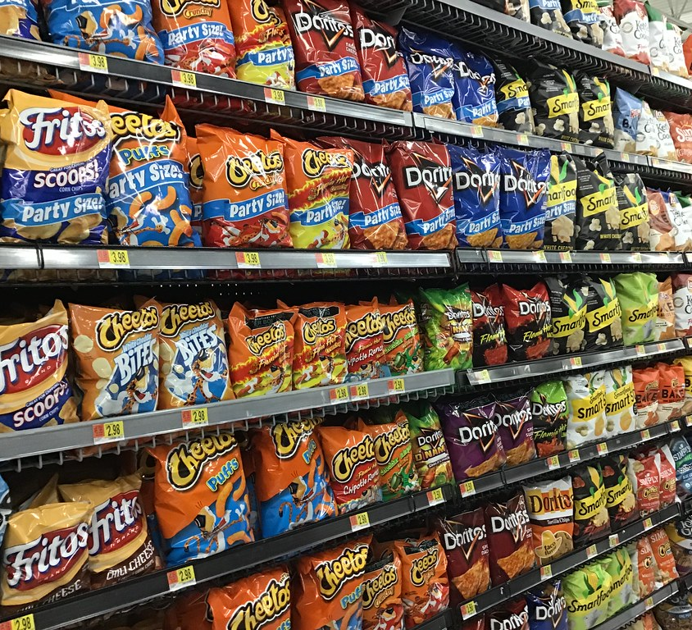
Chips’ purchase Behavior Analysis
TzuYu Liu
This Photo by Unknown Author is licensed under CC BY

Slide 2

Agenda
Chips Category Review
Trial Store Analysis

Slide 3
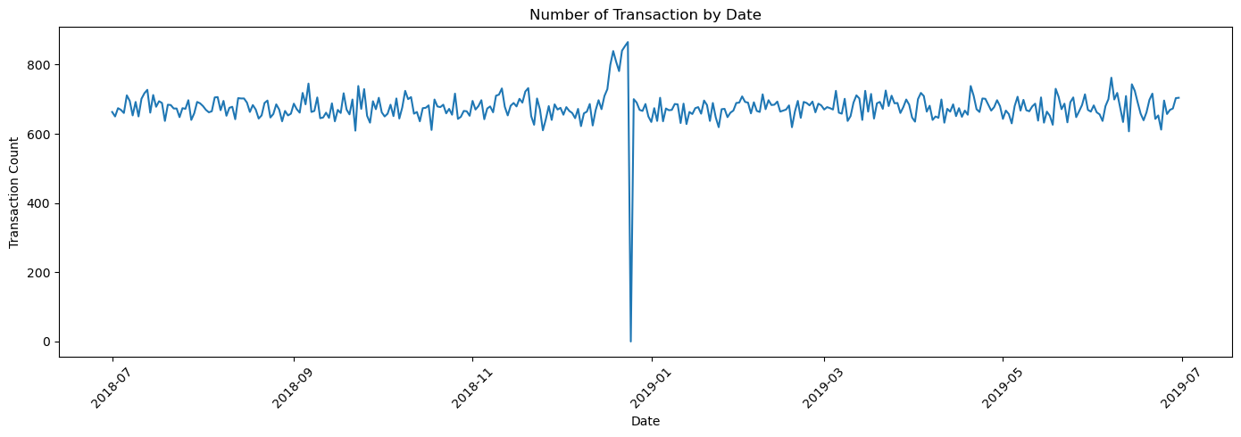
Chip Sales Performance - Daily Transaction Trends
The total number of transactions in the week, including Christmas, was negatively affected by public holiday store closures
The number of Chip transactions has remained consistent over the last 52 weeks. A noticeable increase occurred in the week before Christmas.

Slide 4
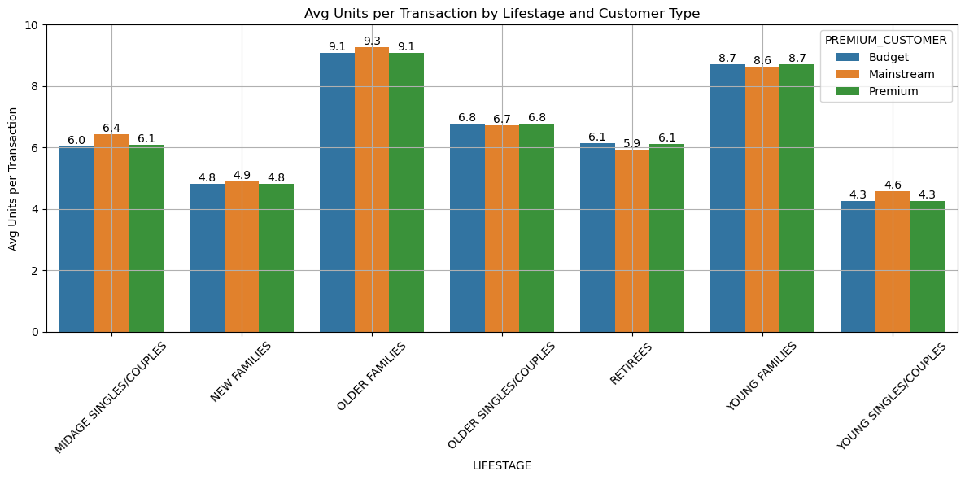
Average units per transaction by affluence and life stage profile
Affluence appears consistent across each individual life stage profile; Older and Young Family shoppers purchase the highest avg units per transaction

Slide 5
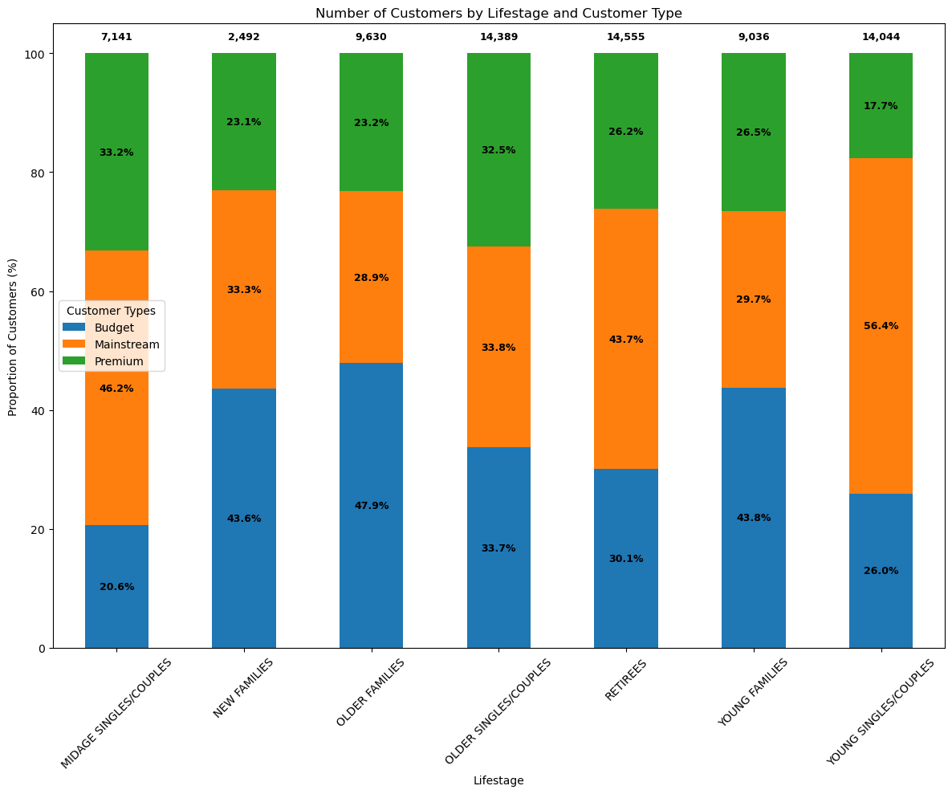
Mainstream Young Singles & Couples make up the largest proportion of Snacking Chips shoppers.
Mainstream Retirees also have a significant share

Slide 6
Trial vs Control Store Performance Evaluation
Experiment Goal: To test whether the new store layout of chips improves customers’ purchasing behaviour.
Experiment Methodology: Compare sales performance between the trial (store id = 77) and the control store (store id = 233) over a four-month period from February to May 2025.

Slide 7
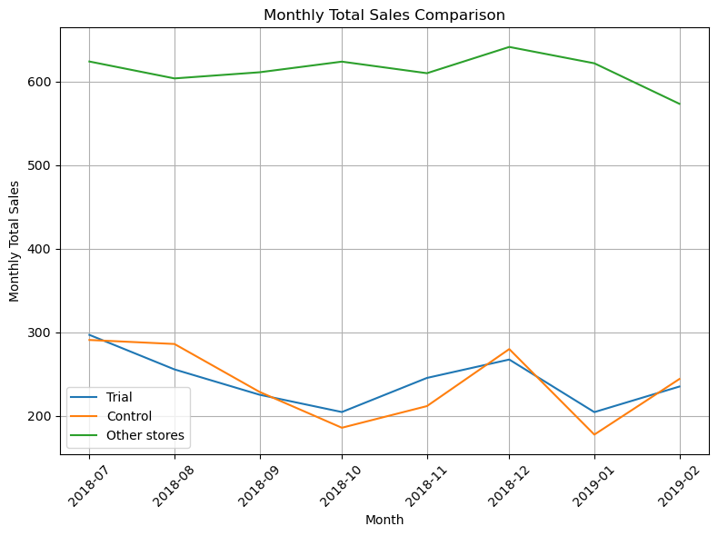
Matching Criteria
Monthly Sales revenue
Monthly Number of customers
Monthly Transaction per customer

Slide 8
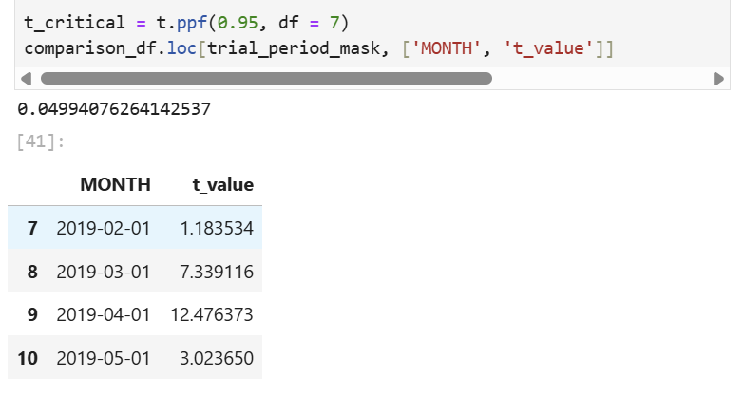
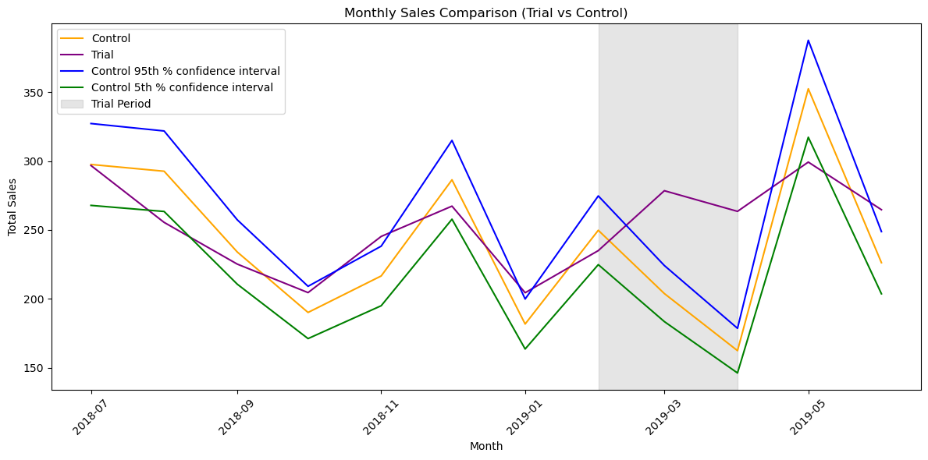
Result
The results show that the trial in store 77 is significantly different to its control store in the trial period as the trial store’s performance lies outside the 5% to 95% confidence interval of the control store in two of the three trial months.

